Slide 1
COST CA19130 Fintech and AI in Finance
COST Innovators Grant

Slide 2
Application Phase
Admin details
The deadline for the application is 24th January 2024, at 11:00 (CET).
Decision: End of April 2024.
Hearings: 23th and 24th May 2024 in Brussels.
Applications submitted by email to CIG@cost.eu by Action Chair or Vice-Chair on behalf of the Management Committee.
One submission allowed per COST Action, submission by the Chair takes precedence.
CIG team needs to be specified beforehand and cannot be changed afterwards, relevant expertise and expected contribution need to be given per team member: link to the excel team members
Glossary: https://www.cost.eu/uploads/2021/10/Annex-II-level-A-Glossary-REVISION.pdf
Useful COST documents: https://www.cost.eu/funding/documents-guidelines/
Content
Action overview (code, name, origin, team members, roles, etc.)
Summary (for publication if the application is approved, between 100 and 500 words)
Research Plan (6 pages)

Slide 3
Project Phase
From application to implementation
Start Date: November 1, 2024
Duration: 12 months

Slide 4
Application Form – Part A
Guidelines
Google drive application form link
COST website application form link
CIG application Part A content:
  Application title
  Application acronym
  Code of COST Action, here is CA19130
  Submitter (must be Action Chair/ Vice Chair)
  Origin of CIG application in the Action
  CIG Grant Holder
  Summary (for publication if the application is approved, between 100 and 500 words)
  Composition of CIG Team.
  Name, email, institution, country of affiliation, role in the CIG, relevant expertise and expected contribution in the CIG for:
    CIG Chair
    CIG Vice-Chair
    CIG Team Members.

Slide 5
Application Form – Part B
Guidelines
Google drive application form link
COST website application form link
CIG application Part B (max. 6 pages):
Innovation Potential (recommended 2 pages):
1.1. What is the practical challenge and target group that you will address?
1.2. What is your proposed solution, what will be the main outcomes of the CIG?
1.3. Objectives of the CIG?
1.4. What is innovative about your solution?
Expected impact (recommended 2 pages):
2.1. Describe who and/or what will benefit, how, when and to which extent.
2.2. Plan for exploitation.
Plan for Implementing the CIG (recommended 2 pages)
3.1. Work plan.
3.2. Intellectual property rights considerations.

Slide 6
Evaluation
1. INNOVATION POTENTIAL
Q1: To what extent does the application describe an innovation challenge, problem or need that is real, relevant, and timely?
Q2: To what extent is the proposed solution innovative, feasible, and adequate in addressing the problem or need described above?
2. EXPECTED IMPACT
Q3: To what extent does the application describe expected impacts that are both significant and credible (realistic)?
Q4: To what extent is the plan for exploitation both realistic and adequate?
3. PLAN FOR IMPLEMENTING THE CIG
Q5: To what extent are the work plan and the team appropriate for achieving the stated objectives of the CIG?
INNOVATION POTENTIAL | EXPECTED IMPACT | IMPLEMENTATION
Total marks for the section = 6 points | Total marks for the section = 6 points | Total marks for the section = 3 points
TOTAL MAXIMUM MARKS AWARDED = 15 points

Slide 7
Brainstorming - Topics which lead to a Business Model, include a justification
Topic 1: Service-a-Software, applying LLMs on Finance to provide information for micro and SME-s. Semantic searching with the help of LLM, Generative AI, defining a cognitive enterprise architecture for M-SMEs to exploit the most recent AI technologies through Cloud Computing.
Topic 2: Green fintech is crucial for directing investments toward sustainable projects, mitigating climate risks, and meeting the increasing demand for eco-friendly financial products, aligning with environmental and consumer expectations. It combines finance and technology to drive innovation for a more environmentally responsible and resilient global economy.
Topic 3: Generative Adversarial Networks for Auction Simulation. Specifically, competitive loan auctions are one of the means for an institutional investor to develop a portfolio. Working in a loan auction environment developed for the secondary loan market, the aim would be for the participants to carry out research and develop a model synthesizing the other auction bidders using a Generative Adversarial Network in order to optimize bidding price.
Topic 4: Since workforce expenditure is included in the financial statements and so released on a yearly basis/ quarterly basis, the goal of the research is to understand if public human capital information can be used to estimate the workforce expenditure of a company. Using LinkedIn, Glassdoor and other social media/ job posts aggregators, the researcher should be able to retrieve information both on the headcount, the roles and the average salary to estimate the workforce expenditure. The performance and results of the analysis should be evaluated at least at company dimension level (SMEs and big companies) and geographical level.
Topic 5: Neural-Symbolic AI for Fintech / Compliance Testing / Contestability: It could be used as a way to regulate / explain / contest LLM predictions in view of the AI Act and GDPR.
Topic 6: Image-based Financial Pattern Recognition (Financial data has deep patterns –trading signals, price anomalies, systemic risks– that are hard to define/extract in a rule-based sense. Deep learning can be employed to identify these patterns.)

Slide 8
Brainstorming - Topics which lead to a Business Model II
Topic 7: Develop workflows for financial service providers to address the requirements of the EU AI act
Topic 8: Initiate R&D service to business and state institutions based on XAI analytics
Topic 9: Empowering Education in the AI Era: Implementing FINTECH and Involving all Actors
Topic 10: Predicting the EU Courts decisions using the Predictive AI
Topic 11: Empowering Education in the AI Era: Implementing FINTECH and Involving all Actors (Training school, for Fintech and AI)
Topic 12: Using machine learning to predict short-term price movement ; the goal is to improve MARCO AVELLANEDA and SASHA STOIKOV market making model with machine learning techniques, by predicting short-term price movements for several timeframes (from 10 to 100 ticks, typically less than a second to 10 seconds). The next step would be to develop a trading framework in a production mode for some cryptocurrencies.

Slide 9
Brainstorming - Topics which lead to a Business Model III

Slide 10
Approach
Collect all ideas with justification why that leads to a business plan by December 21st.
Match those ideas to what everyone has to contribute by mentioning how they contribute during this 1 year.
e.g. google doc where everyone indicates how much they can contribute to each topic.
Decide on 1 topic by Dec 31st.
Write the application by January 25th.
A smaller group will write the application and then ask for approval from everyone before submitting.

Slide 11

2023 Five COST Innovators Grant
Link to the article: https://www.cost.eu/five-new-cost-innovators-grants-2023/

Slide 12
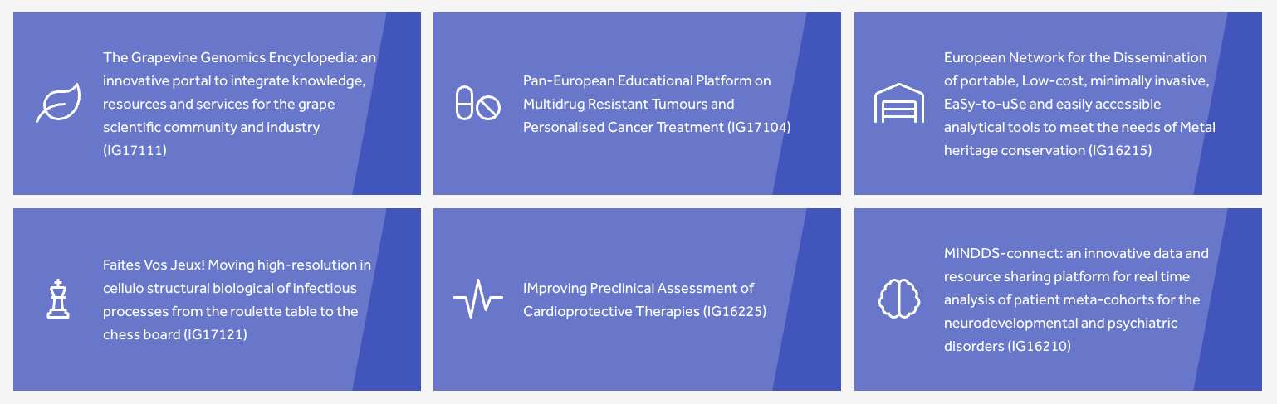
2022 Six COST Innovators Grant
Link to the article: https://www.cost.eu/six-new-cost-innovators-grants/

Slide 13
Appendix

Slide 14
Stylistic Requirements
Find writing style guide here, page 10, section 2.2.2.3.
Checking language and spelling, presenting the text in a logical way, avoiding unnecessary repetition between the different sections;
Use of capital letters for COST-specific and Action-related expressions and explaining all acronyms, including those commonly used in the Framework Programme context;
Use of "Europe" or "COST Member Countries" when referring to the overall geographical scope of COST. "European Union" or "EU Member States" should only be used to refer to the EU as a player ("EU legislation", "EU programmes", "EU policies" etc.) or when only EU Member State(s) need to be explicitly mentioned, excluding COST Members not being Member States of the EU;
Use of "framework" or "scheme" when referring to COST (COST is an intergovernmental framework, not an "EU instrument", although it is funded by the EU Framework Programme);
Avoiding pronouns such as “I”, “we”; rather use “the CIG”;
Avoiding expressions such as “planned” or “proposed” when referring to the CIG; rather use “aims at”, “will”, etc.;
Avoiding overstatements regarding the potential impact of the CIG.
Using of the “CIG application template” and the following COST standard style: Arial font, size 10, line spacing 1 - choose “Normal, Text” style option from the ribbon styles gallery, margins, line spacing, etc. Any application not fulfilling the aforementioned “CIG application template”, will be converted into the standard template by COST. In case of exceeding pages, these will not be provided to CIG Committee for evaluation.
No footnotes;

Slide 15
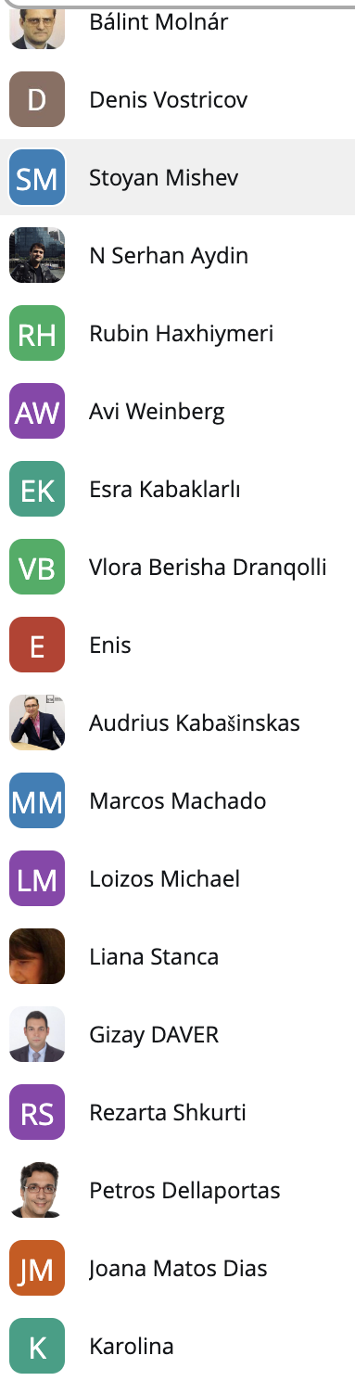
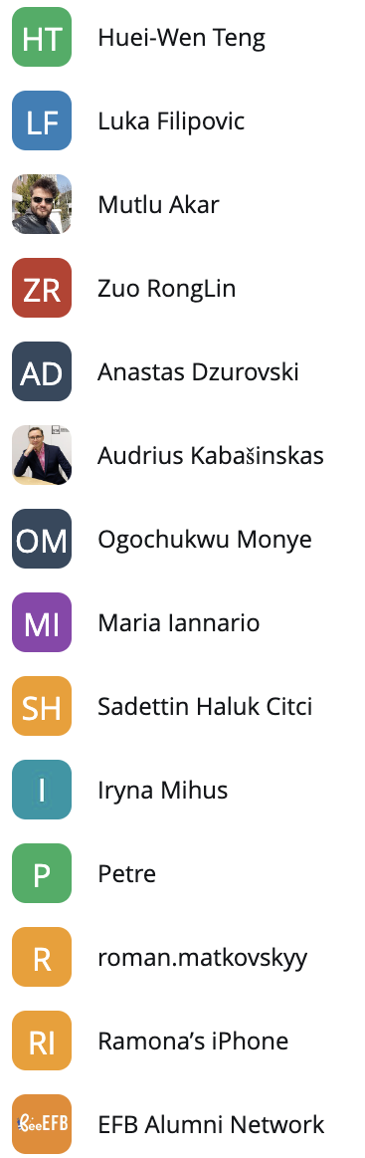
2023.12.14 - Brainstorming Meeting
People

